Slide 1
Week 1 – lesson 1

Slide 2
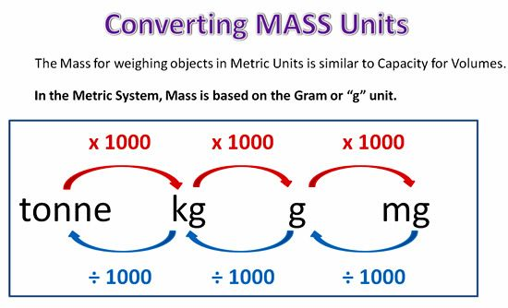
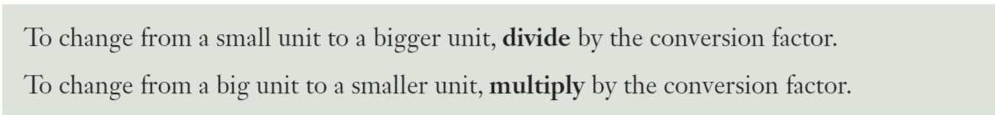
EQ: how do we measure mass?
TOPIC: measurement
What is mass?
The gram is the basic unit for mass and all other mass units were based on the gram

Slide 3
Week 1 – lesson 2

Slide 4
Mathematical Thinking Process Planning Sheet
Interpret the task
Identify the mathematics involved
Analyse information/data (you may need to use other sources)
Apply existing mathematical knowledge and strategies
Verify the reasonableness of your answer

Slide 5
Week 1 – lesson 3

Slide 6
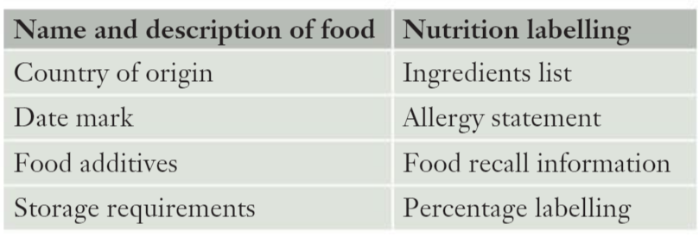
EQ: What’s in our food?
TOPIC: measurement
Australian law requires food manufacturers to provide specific information labels. All food packaging must contain the following information.

Slide 7
Week 1 – lesson 4

Slide 8
Mathematical Thinking Process Planning Sheet
Interpret the task
Identify the mathematics involved
Analyse information/data (you may need to use other sources)
Apply existing mathematical knowledge and strategies
Verify the reasonableness of your answer

